Slide 1
Google Playstore Apps
By David Anderson

Slide 2
Introduction and Goals
Mobile Apps has become a Giant Industry:
2016: 88.3 Billion in Revenue, 90 Billion Downloads
Millions of Apps. How many could you name?
Known issue of false reviews/downloads
Goals of This Study:
Understand Google Play Apps
Categorical Breakdown, Average Ratings, Average Reviews, etc.
Perform Benford Analysis to Investigate Falsely Reviewed Apps

Slide 3

Data Overview
Kaggle Dataset on Scrapped Information
About 10,000 Apps
Dataset With Each Review
Information Available:
Number of Reviews
Overall Rating
App Size
Rough Number of Installs
App Category

Slide 4
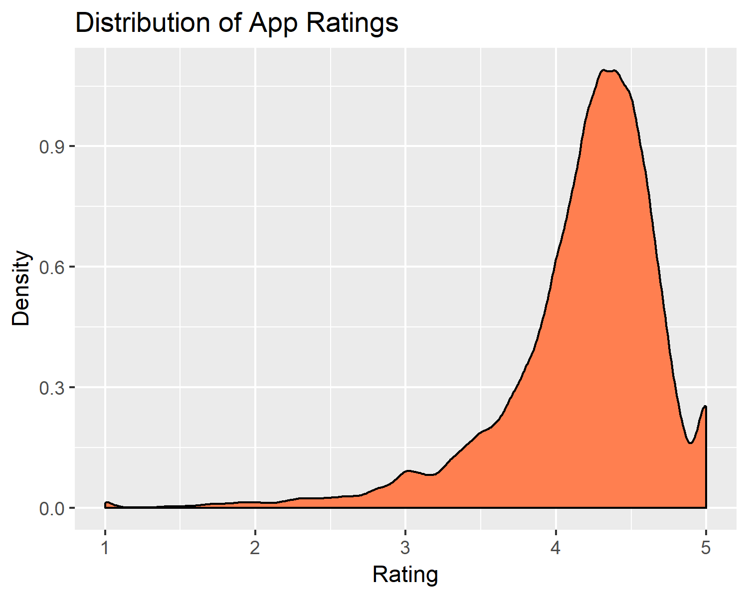
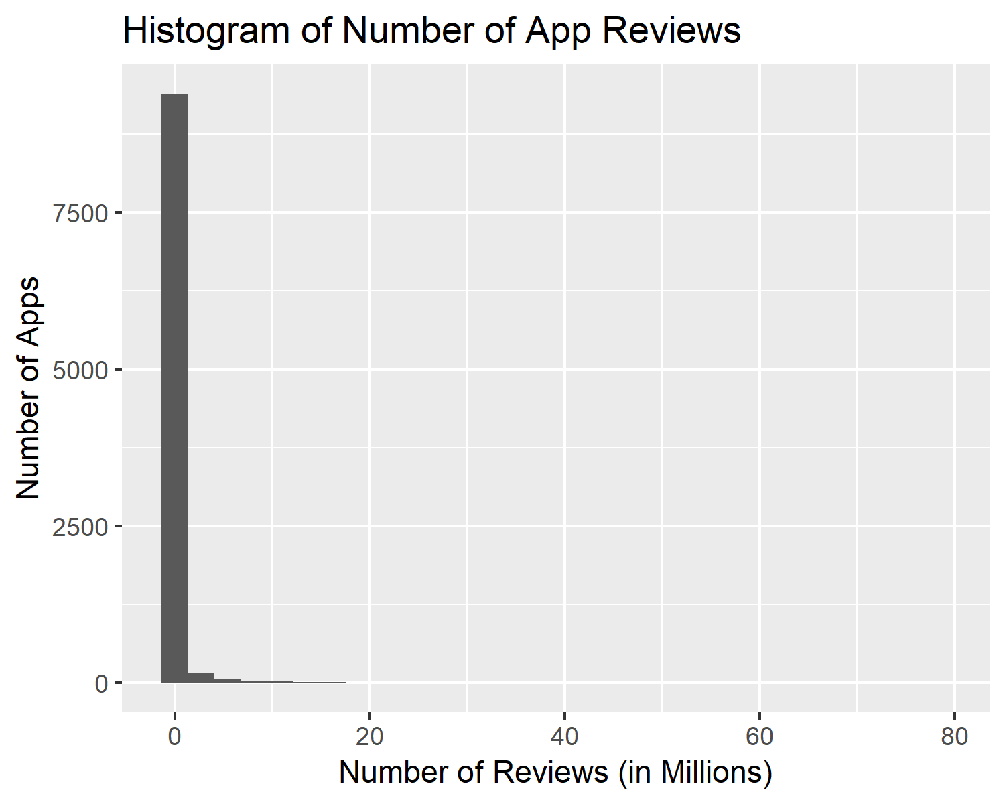
Reviews and Ratings Distributions

Slide 5
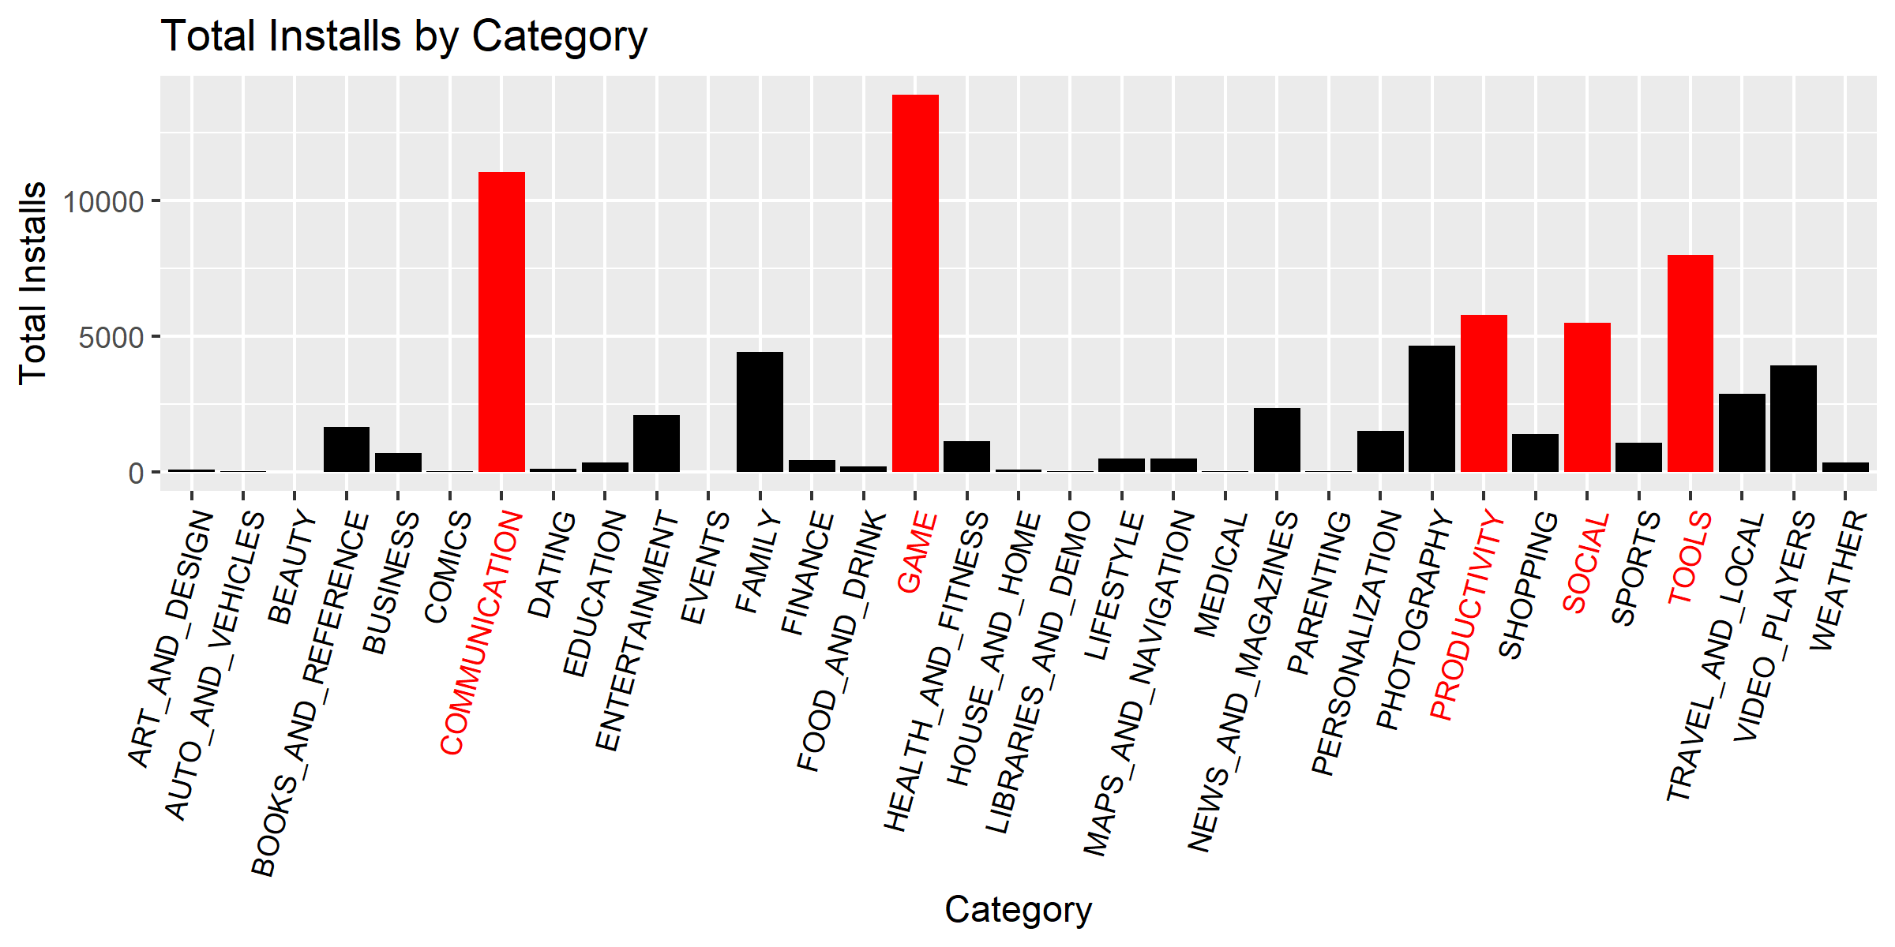
Categories
While the 'Family' category has the most apps, we see that 'Games', 'Communication' and 'Social Media' dominate the downloads

Slide 6
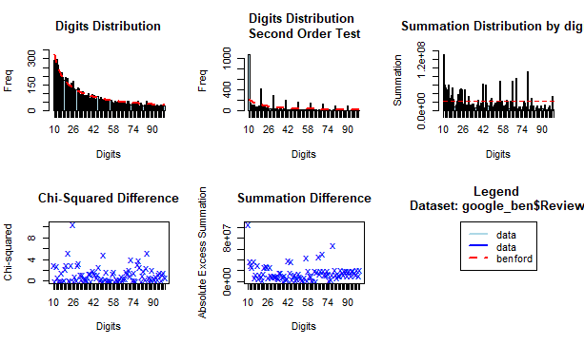
Benford Analysis
Searching for apps with false reviews with Benford Analysis, we see that the distribution of digits is actually fairly consistent with Benford's Law. When searching for suspicious apps, I examined the suspect list from Benford's analysis. Each apps' ratio of reviews to installs was used to create the top suspect apps for false reviews.

